Slide 1
Time-Series Forecasting with Auto encoders
SUBMITTED BY
SANDHYA M
NM ID: au711721243092
KGiSL INSTITUTE OF TECHNOLOGY
3/21/2024 Annual Review

Slide 2
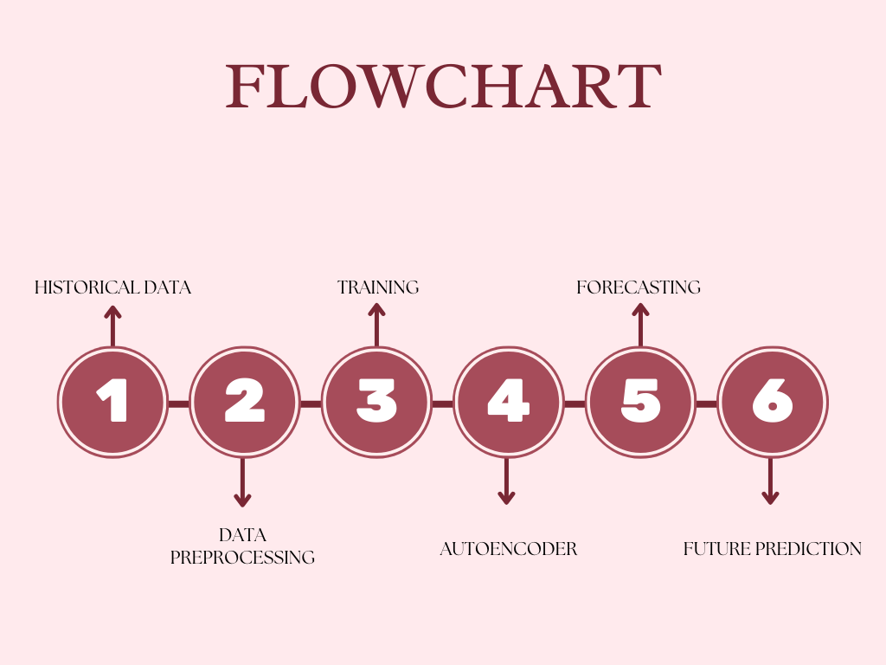
Time-Series Forecasting with Autoencoders
3/21/2024 Annual Review

Slide 3


AGENDA
PROBLEM STATEMENT
PROJECT OVERVIEW
END USERS
SOLUTION AND PROPOSITION
KEY FEATURES
MODELLING APPROACH
RESULT
3/21/2024 Annual Review

Slide 4

PROBLEM STATEMENT
Develop a time-series forecasting model utilizing autoencoders to predict future values accurately. Time-series data represents a sequence of observations collected at regular intervals over time. Traditional forecasting methods often rely on statistical techniques or machine learning algorithms such as ARIMA, LSTM, or Prophet. However, autoencoders offer a unique approach by learning a compressed representation of the input data and reconstructing it, which can be adapted for time-series forecasting tasks.
he objective is to leverage autoencoders to capture the temporal dependencies within the time-series data and generate accurate predictions of future values. This involves designing and training an autoencoder architecture capable of effectively encoding the temporal patterns present in the historical data. The trained model should then be able to decode these encoded representations to forecast future values with minimal error.
3/21/2024 Annual Review

Slide 5

PROJECT OVERVIEW
This project aims to leverage autoencoders for time-series forecasting, with the objective of creating a model that can effectively capture complex temporal patterns present in sequential data.
By encoding and decoding time-series data, the autoencoder enables precise forecasting of future values, providing valuable insights into upcoming trends and behaviors.
3/21/2024 Annual Review

Slide 6

WHO ARE THE END USERS?
Financial analysts can leverage the autoencoder-based time-series forecasting model to anticipate fluctuations in stock prices, currency exchange rates, or other financial metrics, enhancing their ability to make informed investment decisions.
Professionals in the energy sector can utilize the model to predict energy consumption patterns, enhance energy production optimization, and strategize resource allocation to drive greater efficiency and sustainability.
3/21/2024 Annual Review

Slide 7

YOUR SOLUTION AND ITS VALUE PROPOSITION
This project encompasses the generation of synthetic time-series data, the development and training of an autoencoder model, and the subsequent evaluation of its performance. The unique selling point lies in the autoencoder's capability to capture intricate temporal patterns within the data, leading to precise forecasts of future values. This solution provides valuable insights into forthcoming trends and behaviors, empowering informed decision-making across diverse sectors including finance, energy, and healthcare.
3/21/2024 Annual Review

Slide 8
THE WOW IN YOUR SOLUTION
Enabling accurate forecasting of future values
Learns meaningful representations from sequential data
Better understanding
Better prediction of complex temporal dynamics
Decision making across various domains
Offers insights into future trends
Improved Accuracy, Scalability and interpretability of forecasts
3/21/2024 Annual Review

Slide 9
MODELLING
AUTOENCODER MODEL:
The autoencoder model consists of LSTM (Long Short-Term Memory) layers.
It takes a sequence of input data points and learns to encode them into a lower-dimensional representation.
The encoded representation is then decoded back to the original sequence using another set of LSTM layers.
The autoencoder is trained to minimize the mean squared error loss between the input and output sequences, effectively learning to reconstruct the input sequence.
SEQUENCE GENERATION MODEL:
After training the autoencoder, a separate function is used to generate new sequences of future data points.
This function takes a seed sequence as input and iteratively generates new data points by feeding the previous data point into the autoencoder.
The autoencoder learns to predict the next data point based on the previous ones, capturing temporal dependencies in the data.
3/21/2024 Annual Review

Slide 10
DATA GENERATION:
Synthetic time-series data is generated with two sine waves and random noise using the “generate_time_series_data” function.
2. MODEL CREATION AND TRAINING:
An autoencoder model is created using LSTM layers with specified architecture in the “create_autoencoder” function.
The autoencoder model is trained on the generated time-series data using the “train_autoencoder” function. The model is optimized to minimize the mean squared error loss between the input and output sequences.
3. SEQUENCE GENERATION:
After training the autoencoder, a new sequence of future data points is generated using the “generate_new_sequence” function.
This function takes a seed sequence and iteratively predicts future data points based on the learned patterns in the autoencoder model.
4. VISUALIZATION:
Finally, the original seed sequence and the generated future sequence are plotted for comparison using Matplotlib.

Slide 11
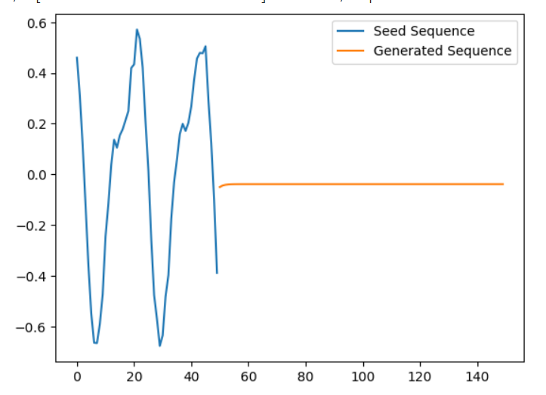
RESULTS
The project's results demonstrate the autoencoder's ability to accurately forecast future values in time-series data, showcasing its effectiveness in capturing temporal patterns and generating precise predictions.
https://drive.google.com/file/d/1E2lLc1FGSRKmYAylv0-BC-nsH2qHvzf7/view?usp=sharing
3/21/2024 Annual Review

